Slide 1

Crime Data
Weston Buck

Slide 2
Initial Algorithm Idea
3 Data Sets –
Crime Data – 10 years: 200MB of time, date, lat, long, and crime type
Permit Data - 10 years: 60MB of address, type and housing renovation costs
Zillow Data – 10 years of locational housing data
Initial concept was to overlay the crime data with permit data to find the high crime areas that turned around when X amount of housing investment was made. I was going to confirm the reversal trend with a rise in housing costs for that specific area using Zillow data. This gives real estate investors a location to scout for future investment gains.

Slide 3
Challenges
Time – Never enough
The permit data didn’t have Lat / Longs so I used the below to convert.
from geopy.geocoders import Nominatim
geolocator = Nominatim()
location = geolocator.geocode("185 Channel street, San Francisco")
print(location.address)
print((location.latitude, location.longitude))
The conversion module would only allow ~50 conversions every few minutes. I had 1.7M rows of data to convert…
The permit data spanned 10 years and they changed the order and column headers every couple years.
Note: I have this cleaned data if anyone's interested.

Slide 4
Resolution
Instead of amalgamating three separate data sets I chose to simplify the project into one set on local crime.
The new goal was find the crime most likely to occur in your specific latitude and longitude. This was far more accurate that other websites as you can input the exact location.
A latitude or longitude with 8 decimal places pinpoints a location to within 1 millimeter or 1/16 of an inch.

Slide 5
Why kNN
kNN is simple to use and is versatile for classification (category) and regression (number).
Although it’s computationally expensive (requires a lot of storage) I didn’t have a lot of irrelevant attributes (outliers) to throw off my numbers.

Slide 6
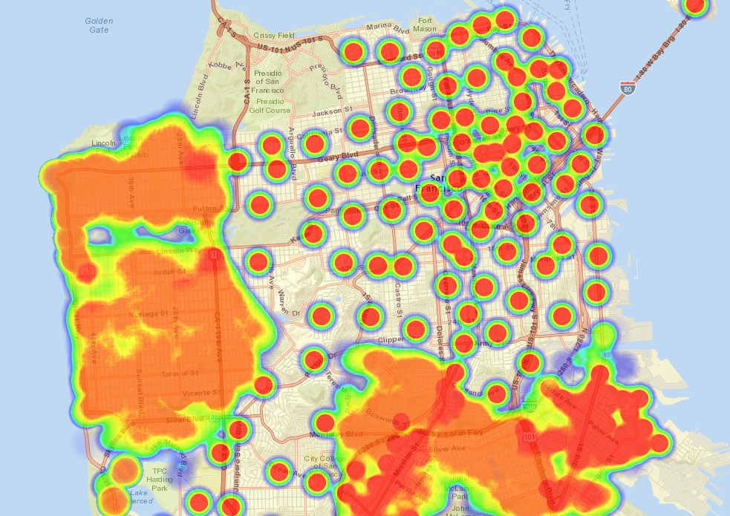
SFData Heat Map

Slide 7
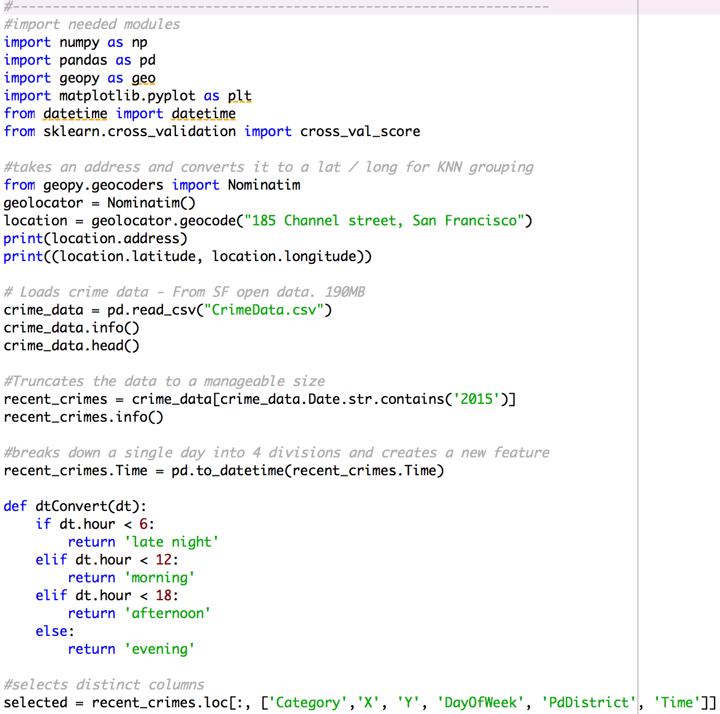
Code Setup
Import all modules.
Find test address lat/long
Read in csv data
Break down “Time” column into four different features

Slide 8
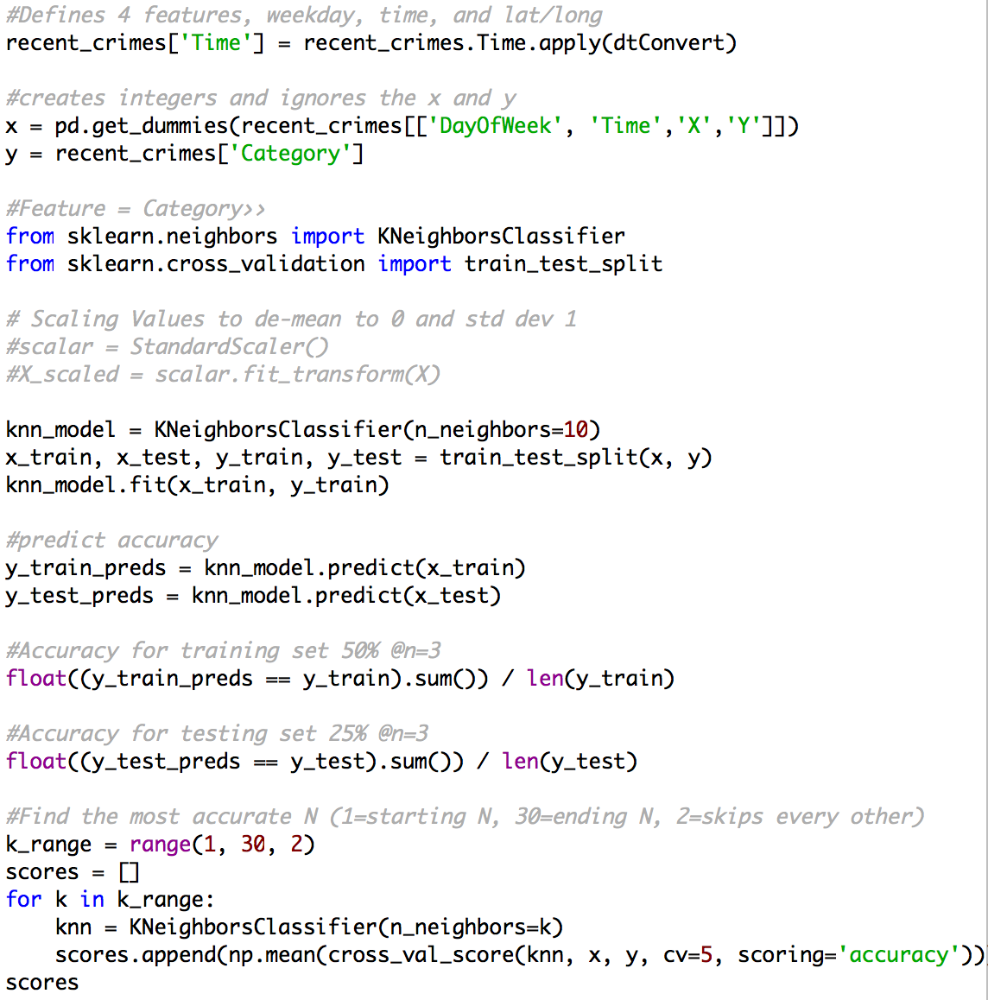
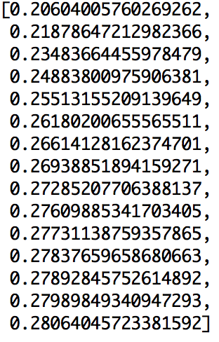
Code Setup Continued
Convert the string into a number for kNN to recognize
Define my y
Train my data and compute accuracy
Find most accurate number of neighbors

Slide 9
kNN
Features: 13 total features. Only two needed.
Latitude
Longitude
Day of week (7 total)
Time of day (4 total)
Day of the week and Time of day were negligible in their accuracy weights. Latitude and Longitude were both the key features.

Slide 10
Conclusion & Questions
Accuracy percentage of 28% with kNN at n=30
Accuracy percentage of 29% with decision trees at a max depth of 5
Accuracy percentage of 30% with random forest at 100 estimators and a max depth of 20.
Question – For my address, on a Wednesday evening in 2015. What crime will most likely to occur?
Vehicle Theft
Assault
Non-Criminal
Vandalism
Larceny
Weapon
7) Drug/Narcotic
8) Burglary
9) Other Offenses
10) Pornography
11) Sex Offenses
12) Embezzlement

Slide 11
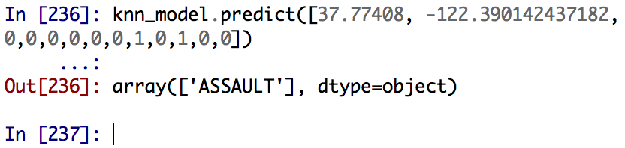
Assault!

